Slide 1
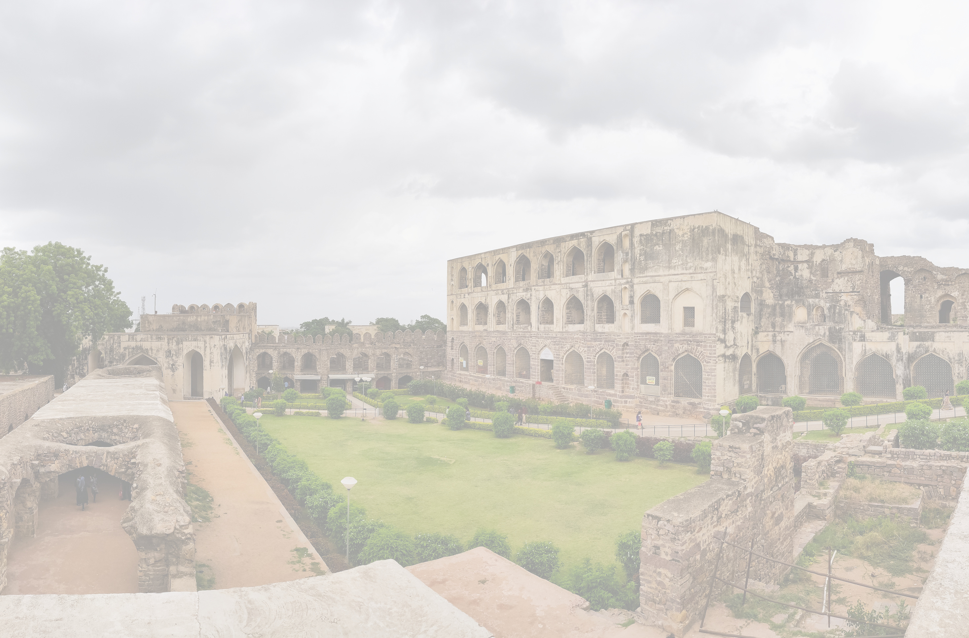
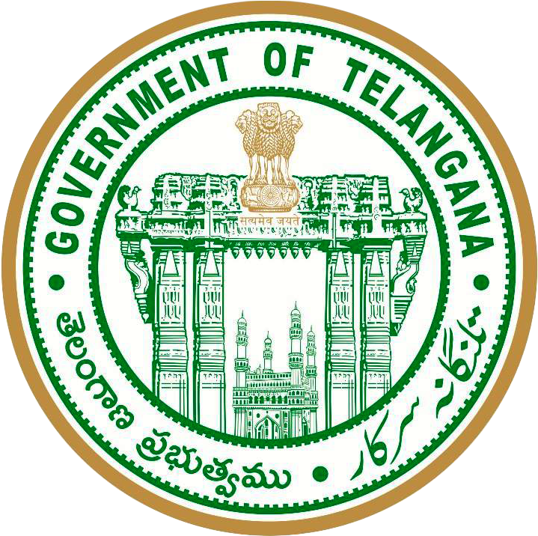

TELANGANA
GROWTH ANALYSIS
PROJECT
Created By : Harshit Arora

Slide 2
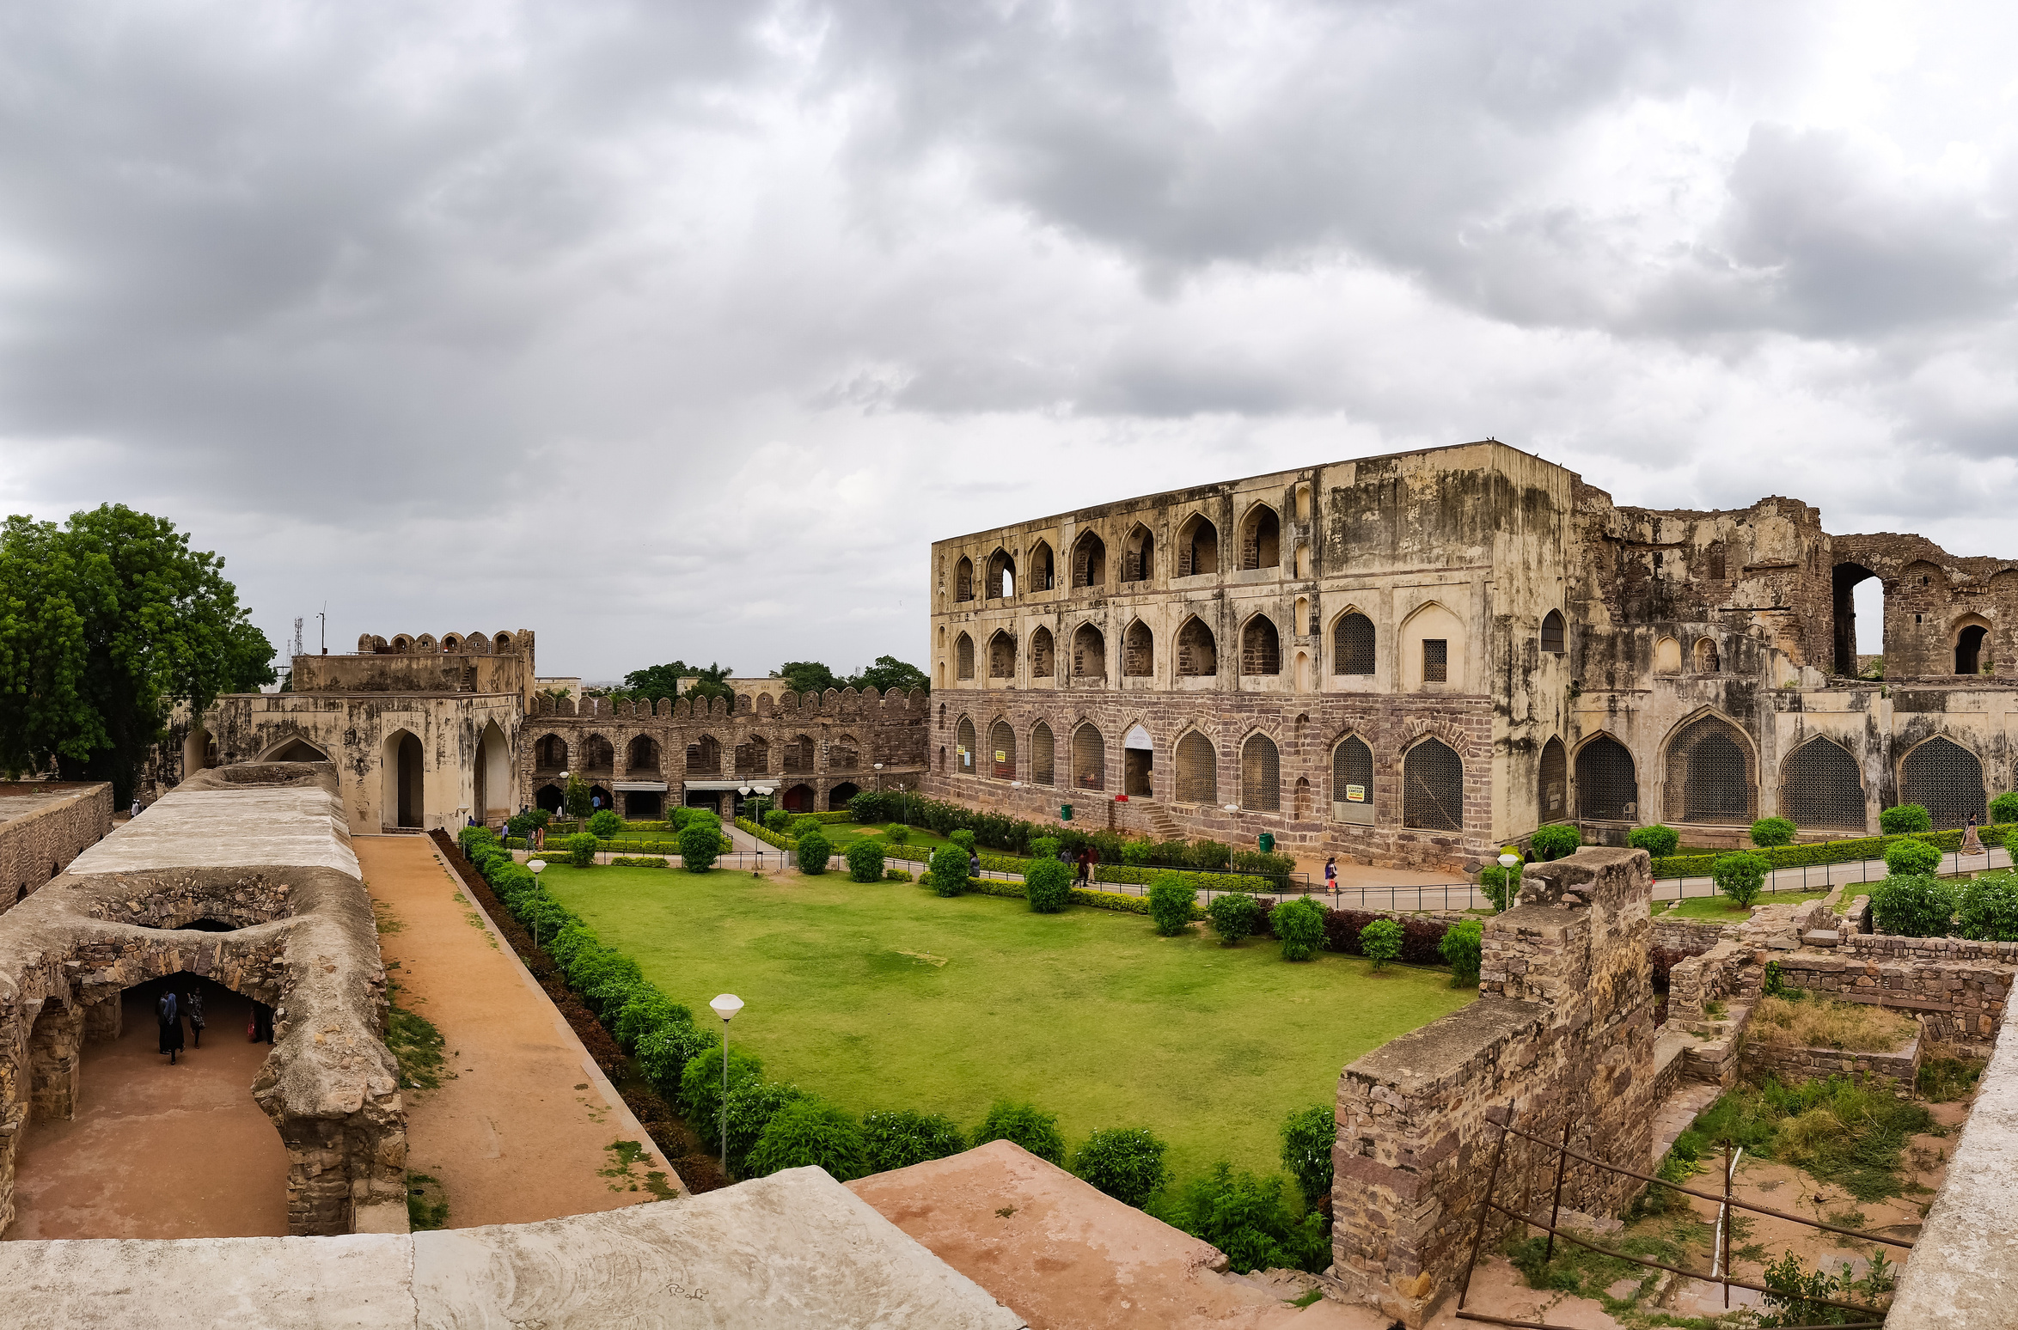
ABOUT TELANGANA
Telangana is a state located in southern India. It was officially formed as a separate state on June 2, 2014, following a prolonged struggle for statehood. Prior to its formation, it was part of the larger state of Andhra Pradesh. Hyderabad is the capital and largest city of Telangana.
Telangana has a diverse economy with agriculture, industry, and services sectors. It is one of the leading producers of rice, cotton, and other agricultural products in India. The state has also witnessed significant growth in the information technology and pharmaceutical industries.

Slide 3
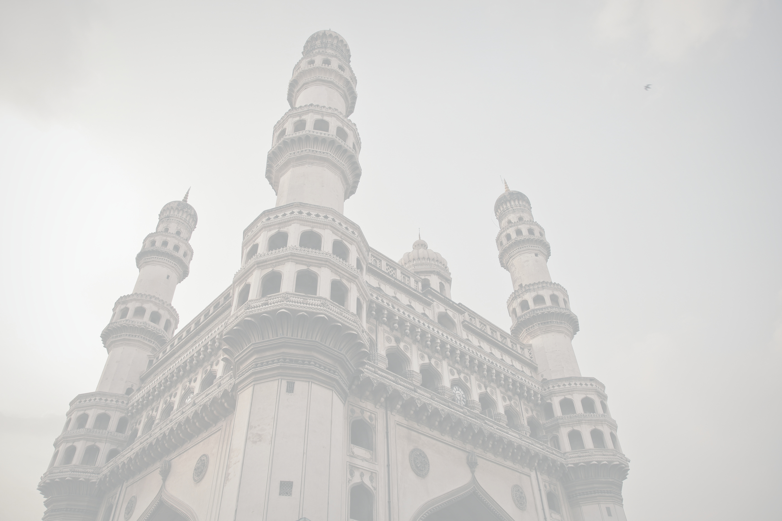
OVERVIEW :
VISION:
Telangana is renowned for its opulent cultural heritage, exquisite historic landmarks, captivating natural beauty, and lively festivals.
Analyse Telangana’s growth among different sectors quantitatively and provide useful Insights to make data-informed decisions that would further support the growth of the state.

Slide 4
OBJECTIVE
1
2
3
4
Explore Stamp Registration, Transportation and Ts-Ipass Datasets. Understand their attributes, categories and time period.
Analyze trends and patterns within each department.
Identify growth opportunities and areas needing attention.
Find correlation among these departments and report the overall growth of the state through insights and relevant visuals such as shape maps.

Slide 5
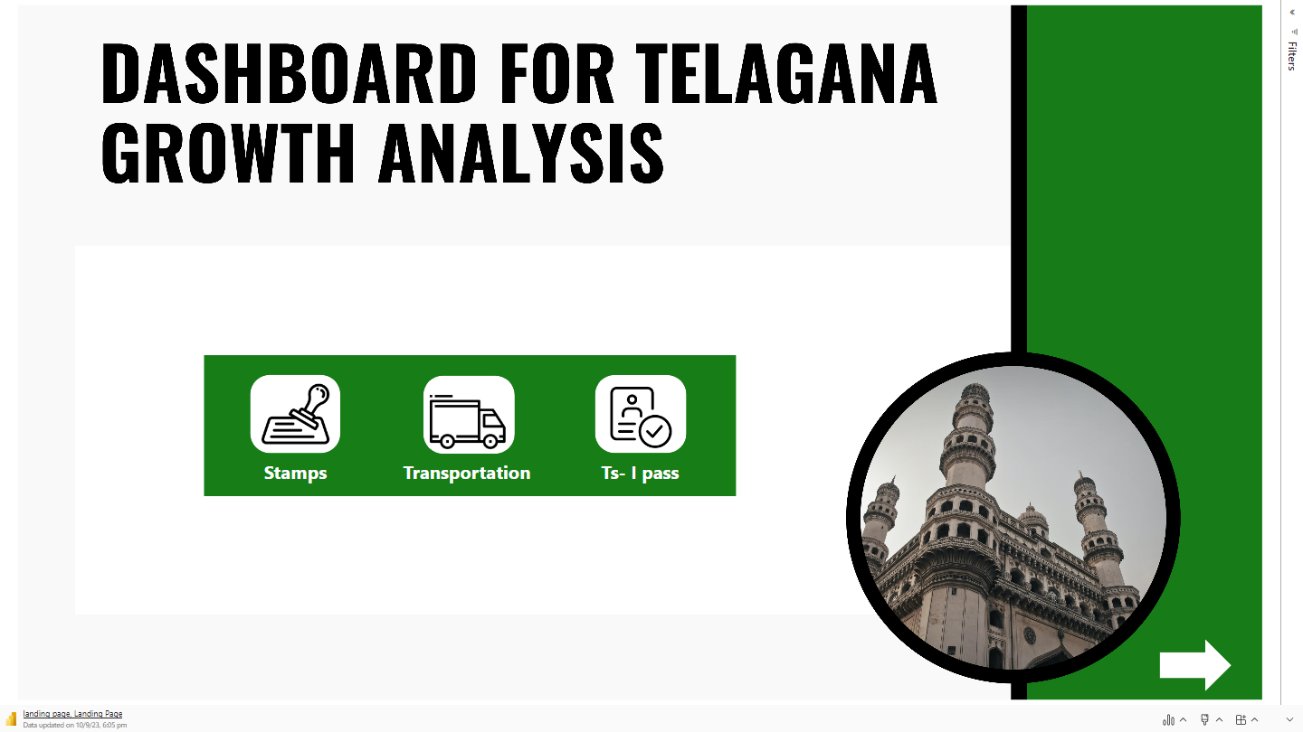

Slide 6
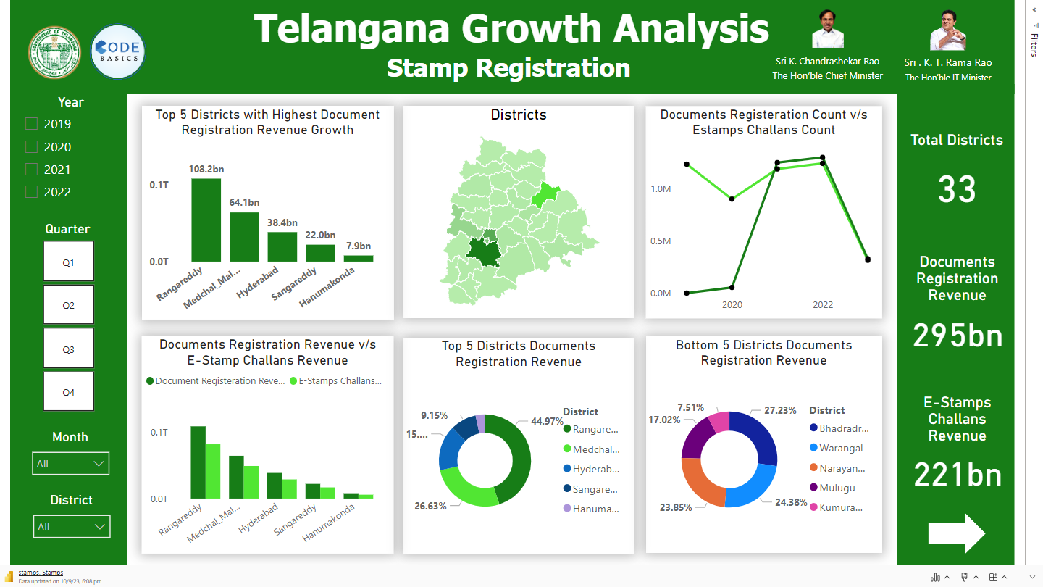

Slide 7
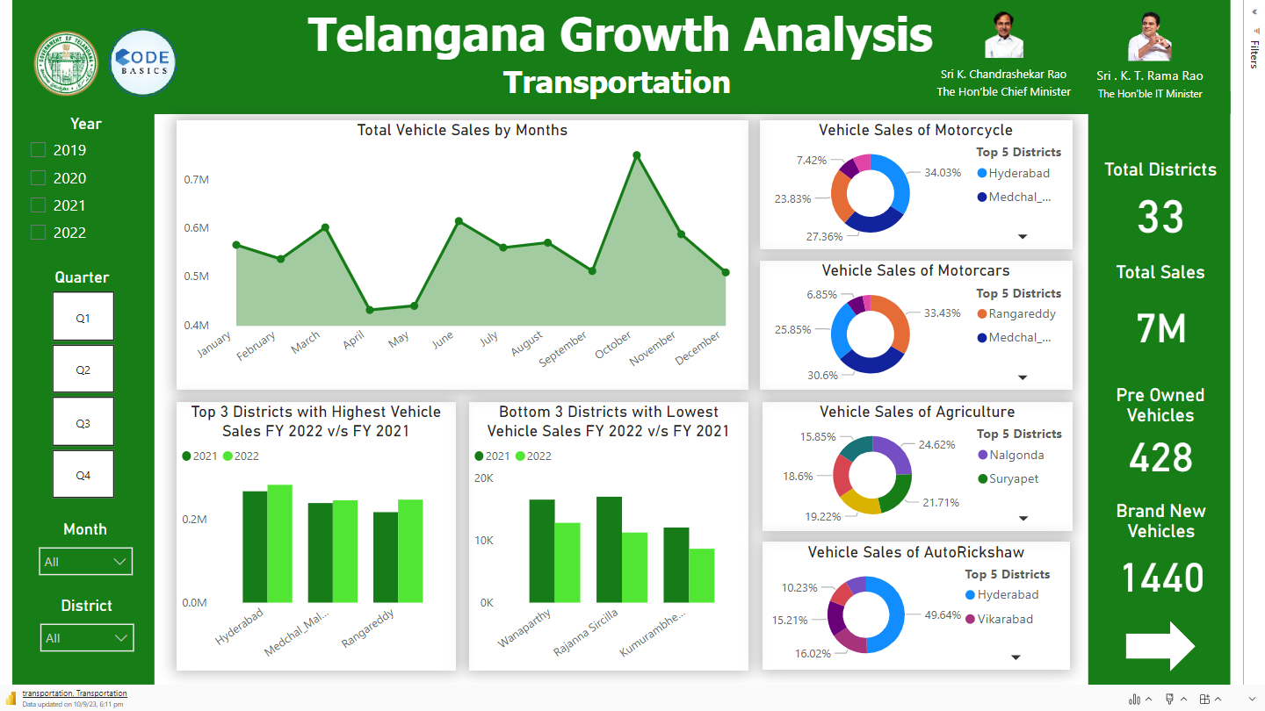

Slide 8
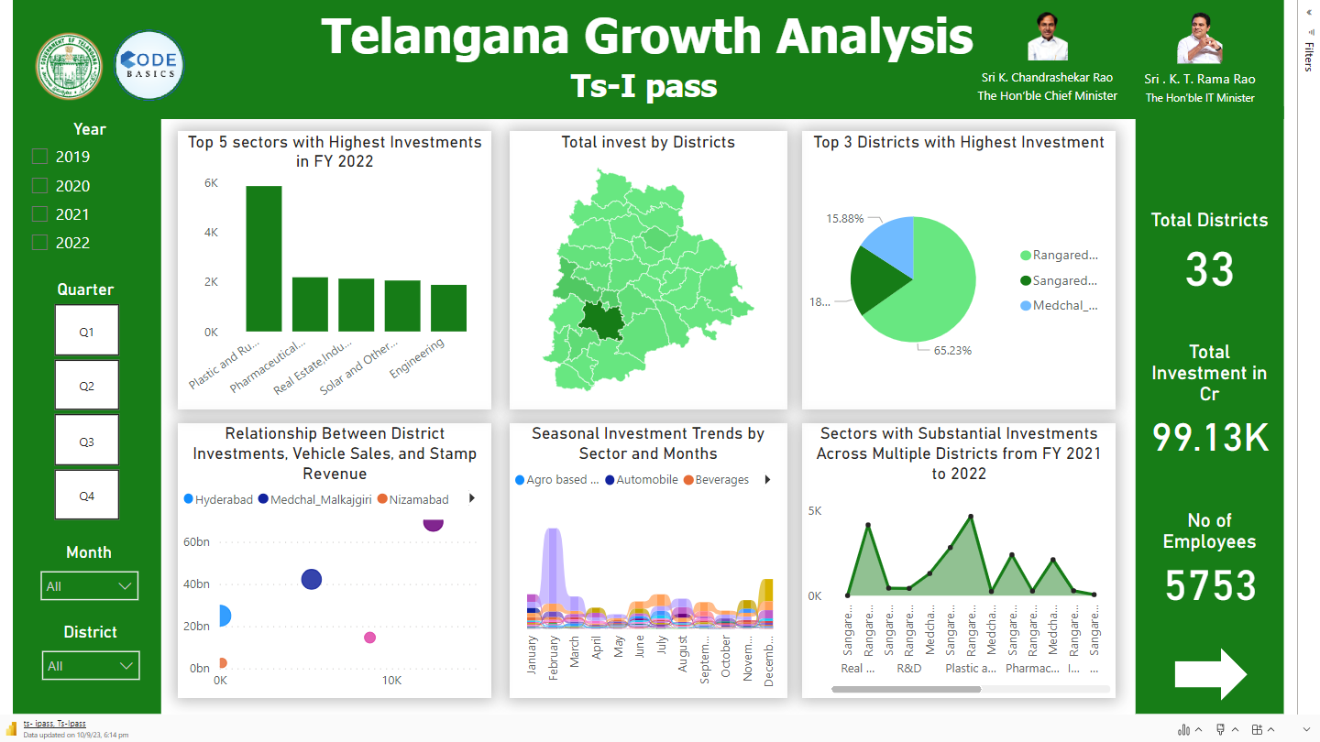

Slide 9
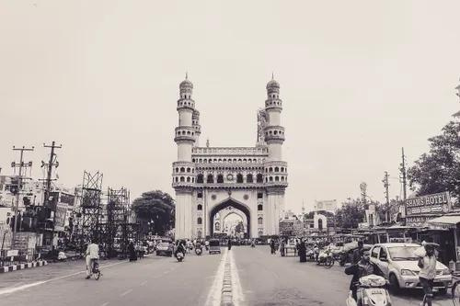
SECONDARY
RESEARCH
INSIGHTS
&
RECOMMENDATIONS

Slide 10
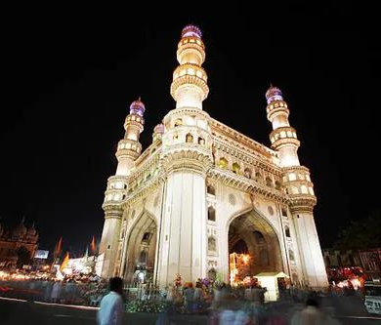
1. What are the top 5 districts to buy commercial properties in Telangana?
5 DISTRICTS
HYDERABAD
RANGAREDDY
MEDCHAL MALKAJGIRI
KUKATPALLY
GACHIBOWLI
The large number of businesses and industries.
These areas is also expected to see significant growth in the coming years, making it a good investment destination.
The commercial properties in these areas are in high demand and offer good returns on investment.

Slide 11
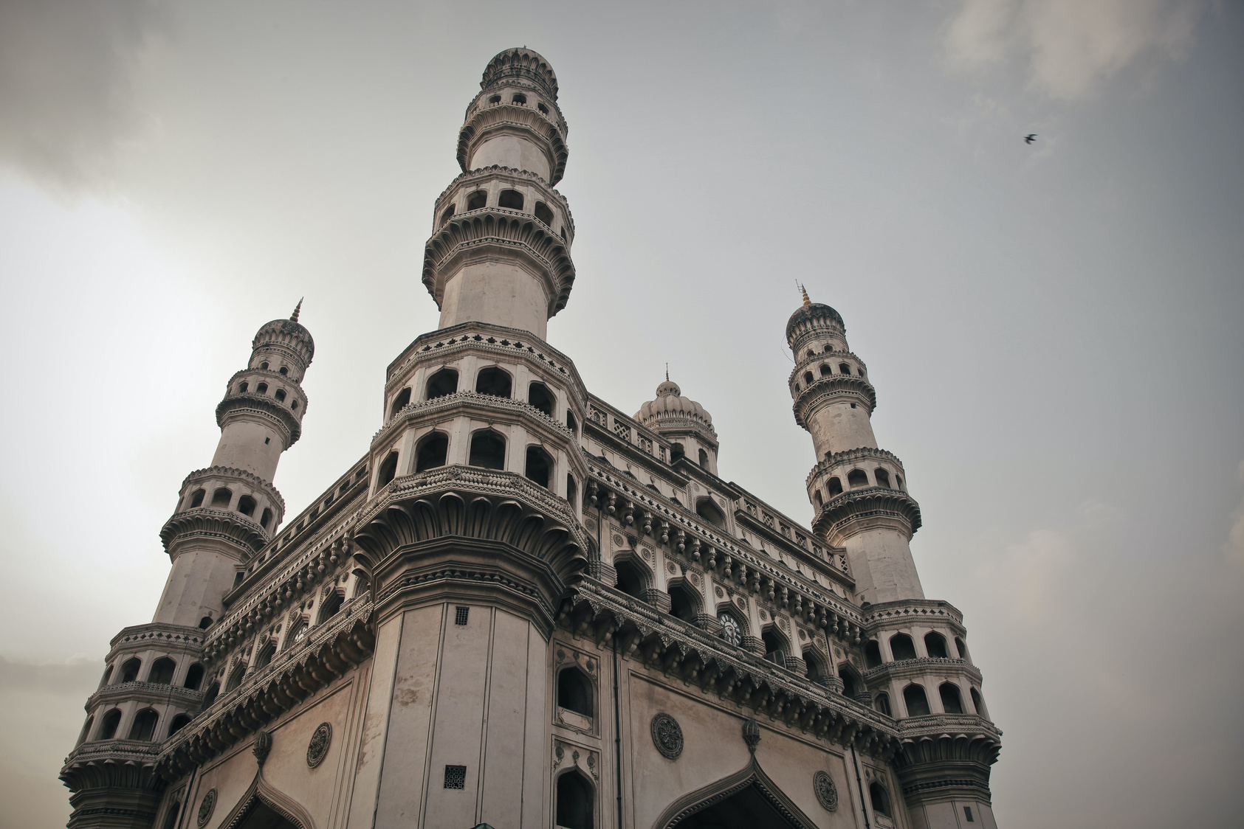



WHAT SIGNIFICANT POLICIES OR INITIATIVES WERE PUT INTO EFFECT TO ENHANCE ECONOMIC GROWTH, INVESTMENTS, AND EMPLOYMENT IN TELANGANA BY THE CURRENT GOVERNMENT?
Telangana State Industrial Project Approval and Self-Certification System (TS-iPASS)
Telangana Information Technology and Electronics Policy
Impact: The policy aimed to make the state more investor-friendly and improve the ease of doing business.
Impact: Data on the number of IT companies established, investments attracted, and employment generated in the IT sector can help quantify the impact.
Telangana State Innovation Cell
Telangana State Tourism Policy
Impact: Tracking the growth of startups, innovations, and the number of jobs created within the startup ecosystem can help assess the impact.
Impact : This policy focuses on promoting tourism in the state, including heritage tourism, eco-tourism, and adventure tourism, which can boost employment in the tourism sector.

Slide 12





Insights
01
Progress and Potential: Telangana has made significant strides in the last five years but still has untapped potential for further development.
Sectoral Opportunities: Telangana is well-positioned to leverage increasing demand in sectors like IT, manufacturing, and healthcare services.
02
03
Agricultural Focus: The state should prioritize efforts to enhance the agricultural sector's productivity and tackle poverty.
Investment Gap: There is a noticeable lack of investment in both Research & Development (R&D) and critical infrastructure projects.
04

Slide 13
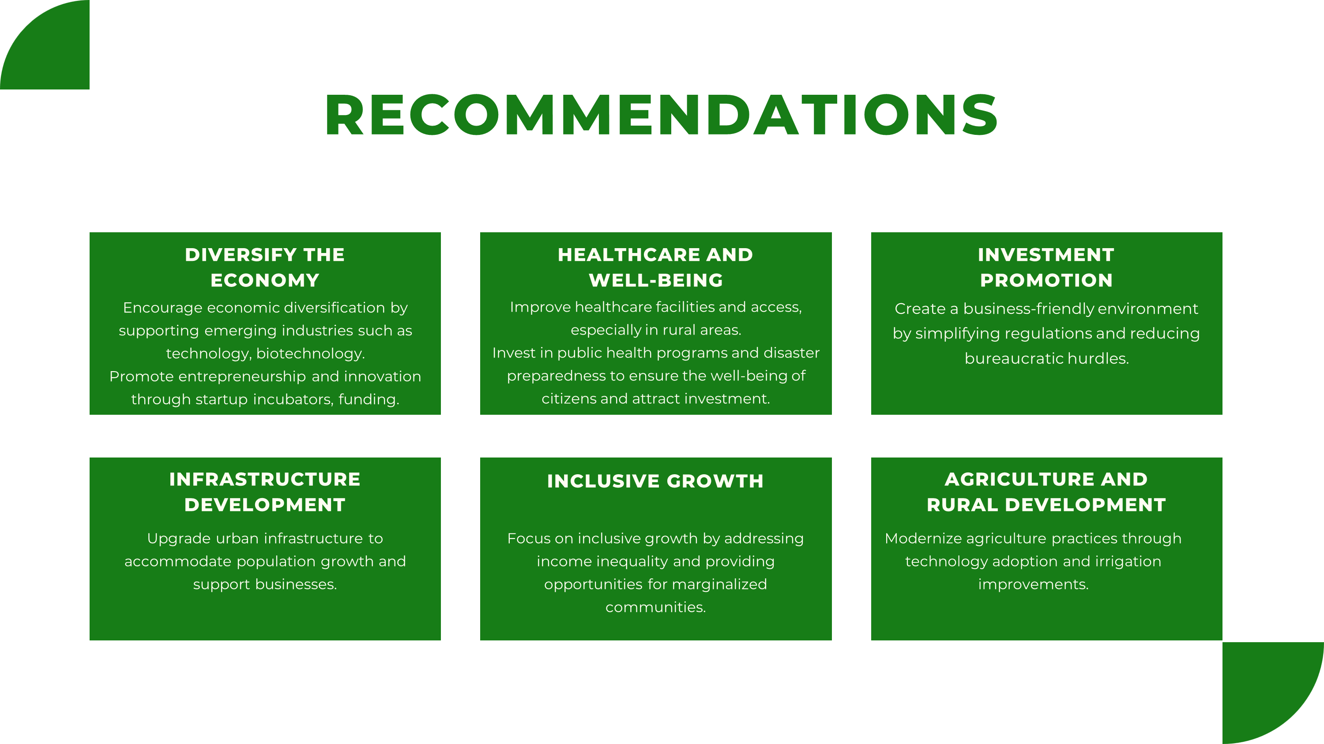

Slide 14

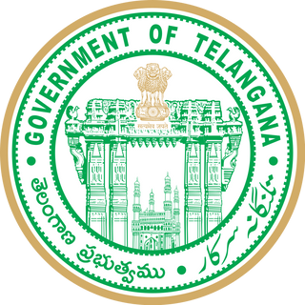

THANK'S FOR WATCHING

